Slide 1

Overview of the project guidelines
Projects A & B

Slide 2
Project goal
Project A
Design a Heart Rate Monitor
Project B
Design a Heart Rate Analyser
Notes:
Moving on, I will briefly discuss the project goals that are slightly different but very related in terms of the analysis done to them. so for project A, our main goal is to display the heart rate in BPM in the command window of a MATLAB program and in project B the main goal is to output a graphical demonstration of the important attributes in ECG data set selected these attributes include peaks, time intervals and duration as shown in the figure adapted from the project guidelines.

Slide 3
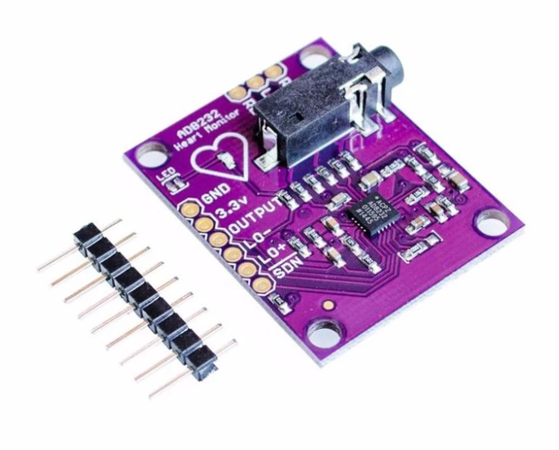
Sensors
“Those ECG data samples have been captured by ECG sensor and have been recorded in multiple MAT files. The recordings were digitized at 360 samples per second with 11 bits resolution over mV range” – Project Guidelines, 2020
The digitizing rate is very critical in terms of the calculations that will be done on the 8 samples.

Slide 4
Design requirements – Project A
Provide an accurate value of the heartrate in bpm from the ECG data samples provided

Slide 5
Design requirements Project B
Pre-filtering of the ECG data samples.
Identifying the important deflections in an ECG waveform (P, Q, R, S & T)
Displaying the attributes labelled on the plot of the sample
Calculating average values for the time intervals ( P-R interval, Q-T interval, QRS duration)
Informing the user if they are out of the normal range

Slide 6
Peak prominence
Image source: Sample 5 of the provided samples

Slide 7
Prominence
“The prominence of a peak measures how much the peak stands out due to its intrinsic height and its location relative to other peaks” (Mathworks, 2020)
I examined the 8 samples and found the common prominence that worked for the 8 of them to be able to identify on the R peaks. This value turned out to be 140 min prominence (Project A) & 170 min prominence (Project B), which I then in association with the findpeaks() command.

Slide 8
R-Peak
Q-Peak
S-Peak

Slide 9
Y-limit

Slide 10
Caused by noise in the sample

Slide 11
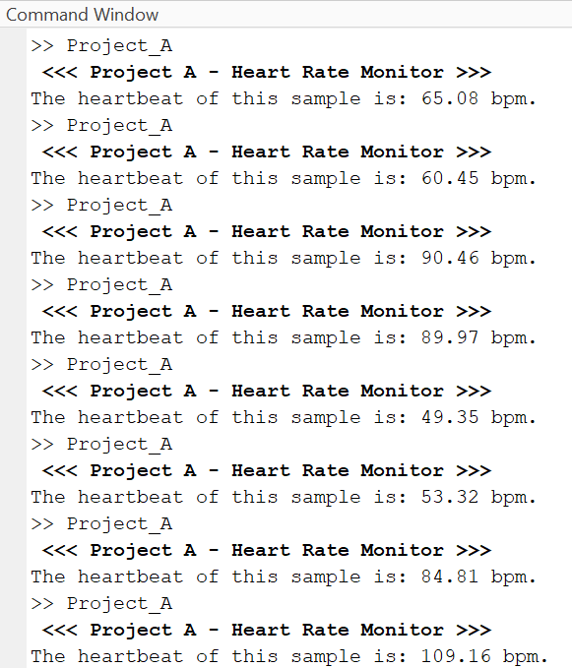
Sample 1
Sample 2
Sample 3
Sample 4
Sample 5
Sample 6
Sample 7
Sample 8

